Slide 1

Comparing Elastic Search queries with Oracle Database SQL
SQL vs NoSQL
Notes:
Fast data arrives in real time and potentially high volume. Rapid processing, filtering and aggregation is required to ensure timely reaction and actual information in user interfaces. Doing so is a challenge, make this happen in a scalable and reliable fashion is even more interesting. This session introduces Apache Kafka as the scalable event bus that takes care of the events as they flow in and Kafka Streams and KSQL for the streaming analytics. Both Java and Node applications are demonstrated that interact with Kafka and leverage Server Sent Events and WebSocket channels to update the Web UI in real time. User activity performed by the audience in the Web UI is processed by the Kafka powered back end and results in live updates on all clients.
Fast data arrives in real time and potentially high volume. Rapid processing, filtering and aggregation is required to ensure timely reaction and actual information in user interfaces. Doing so is a challenge, make this happen in a scalable and reliable fashion is even more interesting. This session introduces Apache Kafka as the scalable event bus that takes care of the events as they flow in and Kafka Streams for the streaming analytics. Both Java and Node applications are demonstrated that interact with Kafka and leverage Server Sent Events and WebSocket channels to update the Web UI in real time. User activity performed by the audience in the Web UI is processed by the Kafka powered back end and results in live updates on all clients. Introducing the challenge: fast data, scalable and decoupled event handling, streaming analytics Introduction of Kafka demo of Producing to and consuming from Kafka in Java and Nodejs clients Intro Kafka Stream API for streaming analytics Demo streaming analytics from java client Intro of web ui: HTML 5, WebSocket channel and SSE listener Demo of Push from server to Web UI - in general End to end flow: - IFTTT picks up Tweets and pushed them to an API that hands them to Kafka Topic. - The Java application Consumes these events, performs Streaming Analytics (grouped by hashtag and author and time window) and counts them; the aggregation results are produced to Kafka - The NodeJS application consumes these aggregation results and pushes them to Web UI - The WebUI displays the selected Tweets along with the aggregation results - in the Web UI, users can LIKE and RATE the tweets; each like or rating is sent to the server and produced to Kafka; these events are processed too through Stream Analytics and result in updated Like counts and Average Rating results; these are then pushed to all clients; this means that the audience can Tweet, see the tweet appear in the web ui on their own device, rate & like and see the ratings and like count update in real time

Slide 2
Topics
Filter & Sort (find, sort)
Aggregation ($group, $project, $match, $sort)
Lookup & Outer Join ($lookup, $arrayElemAt)
Facet Search ($facet, $bucket, $sortByCount)
Update (findAndModify, forEach, save, update, upsert, $set, $unset)
Date and Time operations
Materialized View ($out)
Nested documents/tables ($unwind, $reduce)
Geospatial (ensureIndex, 2dsphere, $near, $geoNear)
Text Search (createIndex, text, $text, $search)
Stored Procedures (db.system.js.save, $where)

Slide 3
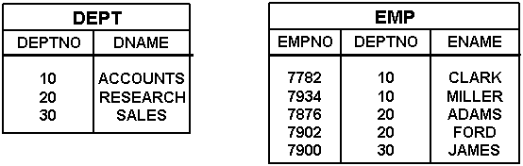
Data Set
HRM
Collections emp and dept – JSON documents in Elastic Search Index
Tables EMP and DEPT – relational records in Oracle Database

Slide 4
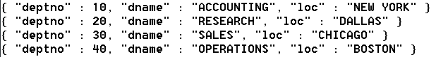
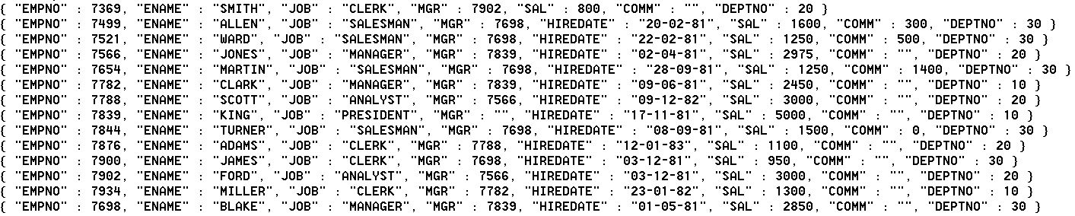
HRM Data SET JSON document Collections emp and dept

Slide 5
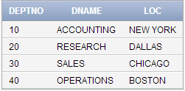
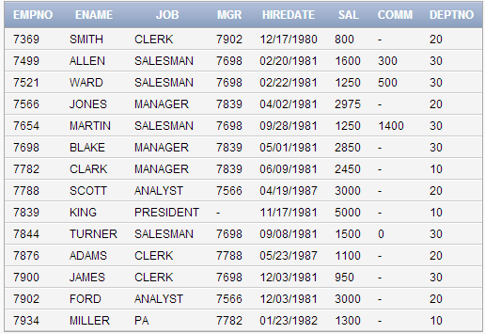
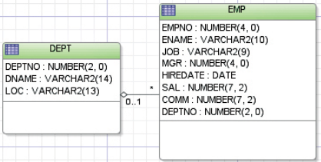
HRM Data Set TABLES EMP and DEPT

Slide 6
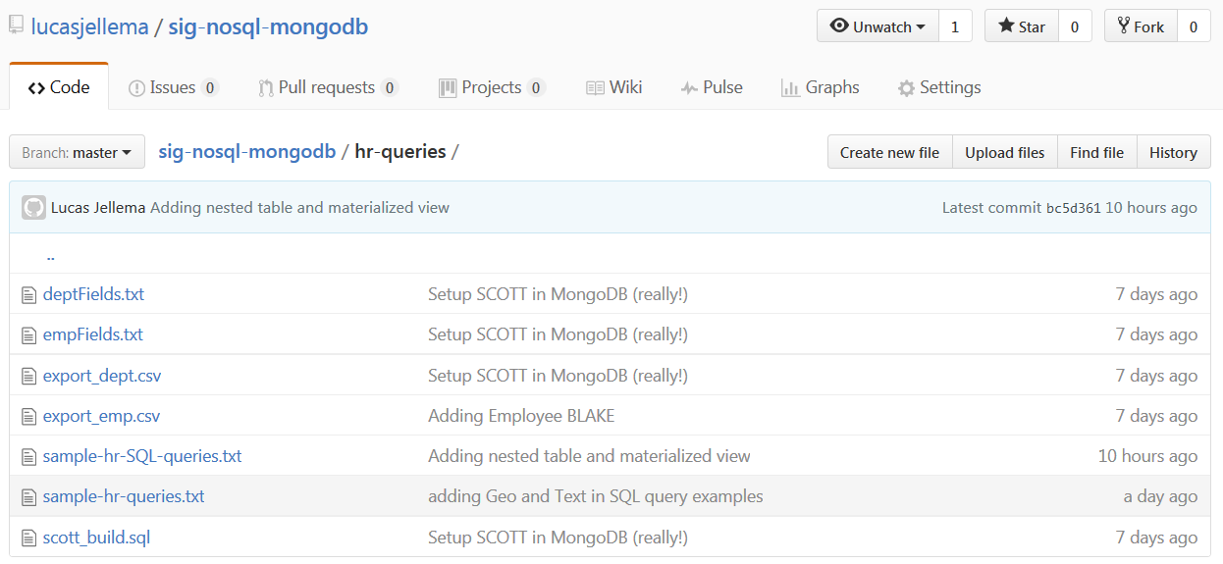
All sources are available on Github
https://github.com/lucasjellema/sig-nosql-mongodb

Slide 7
find the names of all managers
{
"_source": [
"ENAME"
],
"query": {
"bool": {
"filter": {
"term": {
"JOB": "MANAGER"
}
}
}
}
}
select ename
from emp
Where job = 'MANAGER'

Slide 8
find name and salary of Salesmen ordered by salary from high to low
{ "_source": [ "ENAME", "SAL"],
"query": {
"bool": {
"filter": {
"term": {
"JOB": "SALESMAN"
}
}
}
},
"sort": [
{
"SAL": {"order": "desc"}
}
]
}
select ename , sal
from emp
where job = 'SALESMAN'
order
by sal desc

Slide 9
find name and salary of two highest earning Salesmen – best paid first
{ "_source": [ "ENAME", "SAL"],
"query": {
"bool": {
"filter": {
"term": {
"JOB": "SALESMAN"
}
}
}
},
"sort": [
{
"SAL": {"order": "desc"}
}
],
"size" : 2
}
select ename , sal
from emp
where job = 'SALESMAN'
order
by sal desc FETCH FIRST 2 ROWS ONLY

Slide 10
find employees with ‘AR’ in their name – in alphabetical order by name
{ "_source": [ "ENAME", "SAL"],
"query": {
"wildcard": { "ENAME": "*ar*" }
}, "sort": [
{
"ENAME": {"order": "asc"}
}
]
}
select ename , sal
from emp
where ename like '%AR%'
order
by ename

Slide 11
find employees not in department 10, name and salary and sorted alphabetically by name
{ "_source": [ "ENAME", "SAL" ,"DEPTNO"],
"query": {
"bool": {
"must_not": {
"term": {"DEPTNO": "10"}
}
}
}, "sort": [
{
"ENAME": {"order": "asc"}
}
]
}
select ename , sal , deptno
from emp
where deptno != 10
order
by ename

Slide 12
Set DATE type property startdate derived from string type property hiredate
PUT {{ELASTIC_HOME}}:9200/hrm/_mapping/employees
{ "properties": {
"startdate": {
"type": "date",
"format": "dd-MM-yyyy"
}
}
}
POST {{ELASTIC_HOME}}:9200/hrm /employees/_update_by_query?conflicts=proceed
{
"script": {
"source": "ctx._source.startdate = ctx._source.HIREDATE.substring(0,2)+'-' +ctx._source.HIREDATE.substring(3,5)+'-' +ctx._source.HIREDATE.substring(7)",
"lang": "painless"
}
}
alter table emp
add (startdate date) update emp
set startdate = to_date( hiredate, 'DD-MM-RR')

Slide 13
Find Salesmen with a total income higher than 2000
{ "_source": [ "*"],
"script_fields": {
"income": {
"script": {
"lang": "painless",
"source": "long income = doc['SAL'].value + doc['COMM'].value; return income "
}
}
},
"query": {
"bool": {
"must": {
"script": { "script": {
"source": "doc['SAL'].value + doc['COMM'].value > 2000",
"lang": "painless"
}
}
},
"filter": {
"term": { "JOB": "SALESMAN" }
}
}
}
}
select emp.*
, sal + nvl(comm, 0) as income
from emp
where sal + nvl(comm, 0) > 2000

Slide 14
Create stored function salary cap to return max salary per job; use salary cap to find employees earning over their cap
POST {{ELASTIC_HOME}}:9200/_scripts/salary_larger_than_cap {
"script": {
"lang": "painless",
"source": "int cap = 0; String job = doc[params.job_field].value; cap = ( job =='SALESMAN')? (cap = 2000):( ( job =='CLERK')? (cap = 1000):( ( job =='ANALYST')? (cap = 3500):( ( job =='MANAGER')? (cap = 3000):(cap=10000)
))); return doc[params.sal_field].value > cap; "
}
}
{ "_source": [ "ENAME", "SAL" ,"JOB"],
"query": { "bool": { "must": {
"script": { "script": {
"lang": "painless",
"id": "salary_larger_than_cap",
"params": {
"job_field": "JOB", "sal_field": "SAL"
}
}
}
}
}
}
}
create or replace
function salary_cap
(p_job in varchar2)
return number
is
begin
return
case p_job
when 'CLERK' then 1000
when 'ANALYST' then 3500
when 'SALESMAN' then 2000
when 'MANAGER' then 3000
else 10000
end;
end salary_cap;
select ename
, sal
, job
from emp
where sal > salary_cap( job)

Slide 15
Select name, startmonth and startyear for all employees
{ "_source": [ "ENAME"],
"script_fields": {
"startyear": {
"script": {
"lang": "painless",
"source": "long year = doc['startdate'].date.year;
return year "
}
}
, "startmonth": {
"script": {
"lang": "painless",
"source": "long month = doc['startdate'].date.monthOfYear; return month "
}
}
}
}
select ename
, extract (year from startdate) as startyear
, extract (month from startdate) as startmonth
from emp

Slide 16
total salary sum, total number of employees, the highest salary and the earliest startdate
{ "size": 0,
"aggs": {
"total_salary_sum": { "sum": {
"field": "SAL" }
},
"total_staff_count": {"value_count": {
"field": "EMPNO" }
},
"max_sal": { "max": {
"field": "SAL"}
},
"min_startdate": { "min": {
"field": "startdate"}
}
}
}
select sum(sal) total_salary_sum
, count(*) total_staff_count
, max(sal) max_sal
, min(startdate) min_startdate
from emp

Slide 17
total salary sum, total number of employees, the highest salary and the earliest startdate PER DEPARTMENT
{ "size": 0,
"aggs": {
"by_department": {
"terms": { "field": "DEPTNO“ },
,"aggs": {
"total_salary_sum": { "sum": {
"field": "SAL" }
},
"total_staff_count": {"value_count": {
"field": "EMPNO" }
},
"max_sal": { "max": {
"field": "SAL"}
},
"min_startdate": { "min": {
"field": "startdate"}
}
}
}
}
select deptno
, extract (year from startdate) hireyear
, sum(sal) total_salary_sum
, count(*) total_staff_count
, max(sal) max_sal
, min(startdate) min_startdate
from emp
group
by deptno
, extract (year from startdate)

Slide 18
total salary sum, number of employees, highest salary and earliest startdate PER DEPARTMENT and hireyear with number of employees two or more
{ "size": 0,
"aggs": {
"by_department": {
"terms": { "field": "DEPTNO“ },
"aggs": {
"by_department_job": {
"terms": { "script": {
"source": "long year = doc['startdate'].date.year;
return year ",
"lang": "painless"
},
"min_doc_count": 6
},
"aggs": {
"total_salary_sum": { "sum": {"field": "SAL" }
},
"total_staff_count": {"value_count": {
"field": "EMPNO" }
},
"max_sal": { "max": {"field": "SAL"} },
"min_startdate": { "min": {
"field": "startdate"}
}
}
}
}
}
select deptno
, extract (year from startdate) hireyear
, sum(sal) total_salary_sum
, count(*) total_staff_count
, max(sal) max_sal
, min(startdate) min_startdate
from emp
having count(*) > 1
group
by deptno
, extract (year from startdate)

Slide 19
All employees with their department details (when available)
//NO JOINS!!! Redundantly add lookup details
PUT {{ELASTIC_HOME}}:9200/hrm/_mapping/doc
{ "properties": {
"department": {
"properties": {
"DNAME": {
"type": "keyword"
},
"LOC": {
"type": "keyword"
}
} } } }
POST {{ELASTIC_HOME}}:9200/hrm/doc/_update_by_query
{
"script": {
"source": "Map m = new HashMap(); m['LOC'] = (ctx._source.DEPTNO==10?'NEW YORK': (ctx._source.DEPTNO==20?'DALLAS':(ctx._source.DEPTNO==30? 'CHICAGO':'BOSTON'))); m['DNAME'] = (ctx._source.DEPTNO==10?'ACCOUNTING': (ctx._source.DEPTNO==20?'RESEARCH':(ctx._source.DEPTNO==30? 'SALES':'OPERATIONS'))); ctx._source.department= m ",
"lang": "painless"
}
}
POST {{ELASTIC_HOME}}:9200/hrm/doc/_search
{ "_source" : ["*"] }
select e.*
, d.*
from emp e
left outer join
dept d
on (e.deptno = d.deptno)

Slide 20
All departments with a list of the names of their employees
{ "size": 0,
"aggs": {
"by_department": {
"terms": {
"script": {
"source": "long deptno = doc['DEPTNO'].value; String dname= doc['department.DNAME'].value; return deptno + ' '+ dname",
"lang": "painless"
} },
"aggs": {
"staff": {
"terms": {
"field": "ENAME"
, "order":{"_term":"asc"}
}
}
}
}
}
}
select d.deptno, d.dname
, listagg( ename, ',') within group (order by ename) as "staff"
from dept d
left outer join
emp e
on (d.deptno = e.deptno)
group
by d.deptno , d.dname

Slide 21
all employees who work in NEW YORK
{
"_source" : [“*"],
"query": {
"bool": {
"filter":
{ "term":
{ "department.LOC": "NEW YORK" }
}
}
}
}
select e.*
, d.*
from emp e
left outer join
dept d
on (e.deptno = d.deptno)
where d.loc = 'NEW YORK'

Slide 22
Employee named KING with all employees who work under her or him and a neat list of the names of these subordinate staff
select e.*
, cursor( select * from emp s where s.mgr = e.empno ) subordinates
, ( select listagg( s.ename, ',')
within group (order by ename)
from emp s
where s.mgr = e.empno
) as "staff"
from emp e
where e.ename = 'KING'

Slide 23
Facet aggregation: # employees by job, by salary bucket, by department and by startdate (1)
TBD
-- categorizedByJob
select job
, count(*) as "count"
from emp
group
by job
order
by "count" desc
-- categorizedByDepartment
select deptno
, count(*) as "count"
from emp
group
by deptno
order
by "count" desc

Slide 24
Facet aggregation: # employees by job, by salary bucket, by department and by startdate (2)
-- categorizedBySalary
with bucket_boundaries as
( select 10000 lower_boundary from dual
union all
select 2000 lower_boundary from dual
union all
select 3000 lower_boundary from dual
union all
select 10000 lower_boundary from dual
)
, buckets as
( select lower_boundary
, lead(lower_boundary) over (order by lower_boundary)-1 upper_boundary
from bucket_boundaries
)
select lower_boundary
, count(*)
from emp
left outer join
buckets
on (sal between lower_boundary and upper_boundary)
group
by lower_boundary

Slide 25
Facet aggregation: # employees by job, by salary bucket, by department and by startdate (3)
-- categorizedByHiredate
with tiled as
( select ename
, startdate
, ntile(4) over (order by startdate asc) as size_bucket
from emp
)
select size_bucket
, count(*) as "count"
, listagg( ename, ',') within group (order by startdate) employees
from tiled
group
by size_bucket
order
by size_bucket

Slide 26
Create materialized collection from query departments with nested employees
Create index from index using Reindex
Create an index based on an aggregation search result requires the commercial X-Pack feature
create or replace type emp_t as object
( EMPNO NUMBER(4)
, ENAME VARCHAR2(10)
, JOB VARCHAR2(9)
, MGR NUMBER(4)
, SAL NUMBER(7,2)
, COMM NUMBER(7,2)
, STARTDATE DATE
)
create or replace type emp_tbl_t as table of emp_t -- create materialized view
-- with nested table
create materialized view departments
BUILD IMMEDIATE
REFRESH FORCE
ON DEMAND
as
select deptno
, dname
, loc
, cast ( multiset ( select empno, ename, job , mgr, sal, comm, hiredate
from emp e
where e.deptno = d.deptno ) as emp_tbl_t) staff
from dept d
Notes:
https://www.elastic.co/guide/en/elasticsearch/reference/current/docs-reindex.html
https://discuss.elastic.co/t/re-index-aggregation-elasticsearch/75325/2

Slide 27
Find department that contains employee named KING from departments collection with nested employees
{
"_source" : ["DEPTNO","department.*"],
"query": {
"bool": {
"filter":
{ "term":
{ "ENAME": "king" }
}
}
}
}
select d.deptno
, d.dname
, d.loc
from departments d
where ( select count(*) from table(d.staff) where ename ='KING' ) > 0

Slide 28
only find Employee KING (and not all employees in the department) from departments collection with nested employees
select d.deptno
, d.dname
, d.loc
, staff.*
from departments d
, table(d.staff) staff
where staff.ename = 'KING'

Slide 29
Find names of all managers from departments collection with nested employees
select staff.ename
from departments d
, table(d.staff) staff
where staff.job = 'MANAGER'

Slide 30
find all employees who are not in department 10, with their name and salary and sorted alphabetically by name from departments collection with nested employees
select staff.ename
, staff.sal
, d.deptno
from departments d
, table(d.staff) staff
where d.deptno != 10
order
by staff.ename

Slide 31
total salary sum, total number of employees, the highest salary and the earliest startdate, per department from departments collection with nested employees
select d.deptno
, sum(staff.sal) total_salary_sum
, count(staff.empno) total_staff_count
, max(staff.sal) max_sal
, min(staff.startdate) min_startdate
from departments d
, table(d.staff) staff
group
by d.deptno

Slide 32
Adding geo locations and create geo index
PUT {{ELASTIC_HOME}}:9200/hrm/_mapping/doc
{
"properties": {
"department": {
"properties": {
"geolocation": {
"type": "geo_point"
}
}
}
}
}
POST {{ELASTIC_HOME}}:9200/hrm/doc/_update_by_query
{
"script": {
"source": "Map geo = new HashMap(); geo['lat'] = (ctx._source.department.LOC=='NEW YORK'?40.7306: (ctx._source.department.LOC=='DALLAS'?32.7801: (ctx._source.department.LOC=='CHICAGO'?41.8818:32.3548))); geo['lon'] = (ctx._source.department.LOC=='NEW YORK'?-73.93: (ctx._source.department.LOC=='DALLAS'?-96.8005 :(ctx._source.department.LOC=='CHICAGO'?-87.6232:-71.0598))); ctx._source.department.geolocation = geo ",
"lang": "painless"
}
}
-- add column geo_location to hold SDO_GEOMETRY
alter table dept
add (geo_location SDO_GEOMETRY)
-- add geo location to each department
update dept
set geo_location = SDO_GEOMETRY(2001, 8307, SDO_POINT_TYPE (-73.935242, 40.730610,NULL) , NULL, NULL)
where loc = 'NEW YORK'
update dept
set geo_location = SDO_GEOMETRY(2001, 8307, SDO_POINT_TYPE (-96.8005, 32.7801,NULL), NULL, NULL)
where loc = 'DALLAS'
-- insert dimensional meta information for the spatial column
INSERT INTO USER_SDO_GEOM_METADATA
(TABLE_NAME, COLUMN_NAME, DIMINFO, SRID)
VALUES ('DEPT', 'GEO_LOCATION',
SDO_DIM_ARRAY
(SDO_DIM_ELEMENT('LONG', -180.0, 180.0, 0.5),
SDO_DIM_ELEMENT('LAT', -90.0, 90.0, 0.5)
),
8307
);
-- create spatial index
CREATE INDEX dept_spatial_idx
ON dept(geo_location)
INDEXTYPE IS mdsys.spatial_index;

Slide 33
find departments within 500 km from Washington DC ( [ -77.0364, 38.8951 ])
{
"_source" : [“department.*"],
"query": {
"bool" : {
"must" : {
"match_all" : {}
},
"filter" : {
"geo_distance" : {
"distance" : "500km",
"department.geolocation" : {
"lat" : 38.8951 ,
"lon" : -77.0364
}
}
}
}
}
}
with d as
( SELECT loc
, SDO_GEOM.SDO_DISTANCE
( SDO_GEOMETRY(2001, 8307 , SDO_POINT_TYPE ( -77.0364, 38.8951,NULL) , NULL, NULL )
, geo_location
, 0.005
, 'unit=KM'
) distance
from dept
)
select d.*
from d
where d.distance < 500

Slide 34
all departments, the distance for each department in kilometer from Washington DC, ordered by that distance
{
"_source" : ["*"],
"query" : {
"match_all": {}
},
"script_fields" : {
"distance_km" : {
"script":{
"lang": "painless",
"source" : "0.001 * doc['department.geolocation'] .arcDistance(params.lat,params.lon)",
"params" : {
"lat" : 38.8951,
"lon" : -77.0364
}
}}
}
}
with d as
( SELECT loc
, dname
, SDO_GEOM.SDO_DISTANCE
( SDO_GEOMETRY(2001, 8307 , SDO_POINT_TYPE ( -77.0364, 38.8951,NULL) , NULL, NULL )
, geo_location
, 0.005
, 'unit=KM'
) distance
from dept
)
select d.dname
, d.loc
, d.distance “distance from Washington DC”
from d
order
by d.distance

Slide 35
Add biographies to employees (preparing for text index and search) and create text index
{ "update" : {"_id" : "7839" } }
{"doc": {"biography":"Gerald Ford was .. in 2006."}}
{ "update" : {"_id" : "7902" } }
{"doc": {"biography":"Harrison Ford is ...Han Solo." }}
PUT {{ELASTIC_HOME}}:9200/hrm/_mapping/doc
{
"properties": {
"biography": {
"type":"text"
}
}
}
update emp
set bio = q'[Gerald Ford was born ... in 2006.]'
where ename = 'KING‘
update emp
set bio = q'[Jamaican sprinter Yohan Blake holds ...]'
where ename = 'BLAKE'
-- create a multi column text index
exec ctx_ddl.create_preference ( 'my_mcds', 'multi_column_datastore' )
exec ctx_ddl.set_attribute ( 'my_mcds', 'columns', 'bio, ename, job' )
-- to support stemming
exec ctxsys.ctx_ddl.create_preference ('my_lexer','BASIC_LEXER');
exec ctxsys.ctx_ddl.set_attribute ('my_lexer','index_stems','1');
exec ctxsys.ctx_ddl.create_preference ('my_wordlist','BASIC_WORDLIST');
exec ctxsys.ctx_ddl.set_attribute ('my_wordlist','stemmer','ENGLISH');
create index emp_txt_idx on emp( ename )
indextype is ctxsys.context
parameters( 'datastore my_mcds WORDLIST my_wordlist LEXER my_lexer' )

Slide 36
which employees are found when looking for someone to lead (and why & where)?
{
"_source" : ["ENAME","biography"],
"query": {
"simple_query_string": {
"fields": [ "biography","JOB" ],
"query": "lead"
}
},
"highlight": {
"fields" : {
"biography" : {}
}
}
-- leveraging the multicolumn text index -- on ename, bio and job
SELECT ename
, SCORE(1)
FROM emp
WHERE CONTAINS(ename, 'lead', 1) > 0

Slide 37
Text search including scoring - applying weight and deriving applicability
// WORK IN PROGRESS
{
"_source" : ["ENAME","biography"],
"query": {
"simple_query_string": {
"fields": [ "biography","JOB" ],
"query": "manager"
}
}
}
-- leveraging stemming and the multicolumn text index -- on ename, bio and job
SELECT ename
, SCORE(1) score
FROM emp
WHERE CONTAINS(ename, '$manage', 1) > 0
order
By score desc

Slide 38




Thank you!
Blog: technology.amis.nl
Email: lucas.jellema@amis.nl
: @lucasjellema
: lucas-jellema
: www.amis.nl, info@amis.nl

